Slide 1
Model Tuning, Assessment and Selection

Slide 2
Model fitting issues
One of the goals of machine learning is generalizability.
If your model works only on your training data, the model is effectively useless.
Depending on the training process your model might be
Underfitted
Overfitted
Well fitted

Slide 3
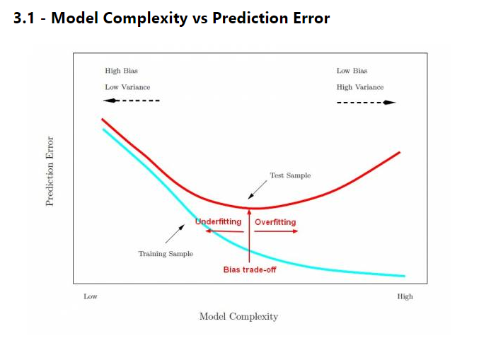
Overfitting vs Underfitting
There are two issues when it comes to model fitting:
Overfitting
Over-fitting generally occurs when a model is excessively complex.
A model that has been overfit will generally have poor generalization capabilities, as it can perform errors due to minor fluctuations in data dues to noise and other parameters which were not modeled during the training process.
Underfitting
Underfitting occurs when a model is over simplified.
Easy to avoid
Just train your model on a bigger data set

Slide 4
How to avoid overfitting?
The more complex the problem gets, the more complex the algorithm needs to be
Most tasks in this current day and age are complex
How to avoid overfitting?
The easiest way to avoid overfitting is to have a very large training data
Too big to overfit
You’ve seen it all for you to overfit
Reduce model complexity
Choose models that generalize well
Regularization
A more sophisticated way to avoid overfitting

Slide 5
Regularization
Regularization is a process of introducing additional information in order to solve an ill posed problem or to prevent overfitting.
It adds a regularization term in order to prevent the coefficients to fit so perfectly to overfit.
Examples of regularization methods:
L1 and L2 are the most common types of regularization
Early stopping
Other regularization parameters

Slide 6
Regularization: L1 and L2
The difference between the L1 and L2 is just that L2 is the sum of the square of the weights, while L1 is just the sum of the weights.
They update the general cost function by adding another term known as the regularization term.
L1 regularization on least squares
L2 regularization on least squares:
Difference between L2 and L1 regularization
http://www.chioka.in/differences-between-l1-and-l2-as-loss-function-and-regularization/

Slide 7
Early Stopping
Early stopping can be viewed as regularization in time.
Intuitively, a training tends to learn more complex functions as the number of iterations increases.
By regularizing on time, the complexity of the model can be controlled, improving generalization.
Early stopping is implemented by splitting the data into training, validating, and testing set
You can train using a training set and then measure the accuracy on a statistically independent validation set.
The training continues until performance on the validation set no longer improves.
The model is then tested on a testing set.

Slide 8
Early Stopping: Validation set vs cross validation
The validation set is used for validation only
The model “never” sees it during training
Cross validation is a different way of generalization
In cross validation, or k-fold cross svalidation, the training data is split into multiple sets (as many as k)
The model uses (k-1) sets for training and the last set for validation
The validation set is rotated
Achieves generalization while maintaining regularization
K-fold cross validation is used when your training dataset is not large enough that you can set aside part of it for only validation.

Slide 9
Model Validation
Discussion:
The fitting issues reflects the fact that the trained models do not generalize to unseen data.
Therefore, there is a need to validate the models before testing it on unseen data.
The validation affects the choice of model parameters in training.
Python “sklearn” does that for you.
For example, you can use LogisticRegressionCV instead of LogisticRegression

Slide 10
Regularization Parameters tuning
Parameter Tuning in Logistic Regression
Remember that we use parameter C (C=1/ λ) as our regularization parameter.
Lambda (λ) controls the trade-off between allowing the model to increase it's complexity as much as it wants with trying to keep it simple.
If λ is very low or 0, the model will have enough power to increase it's complexity (overfit) by assigning big values to the weights for each parameter.
If we increase the value of λ, the model will tend to underfit, as the model will become too simple.
The problem of finding the right set of parameters such that the model can “optimally” solve the problem is called Hyper-Parameter Optimization.

Slide 11
Model Parameters
A model parameter is a configuration variable that is internal to the model and whose value can be estimated from data.
They are required by the model when making predictions.
They values define the skill of the model on your problem.
They are estimated or learned from data.
They are often not set manually by the practitioner.
They are often saved as part of the learned model.

Slide 12
Model Hyper-Parameters
Hyperparameter is a parameter whose value is set before the learning process begins.
They are often used in processes to help estimate model parameters.
They are often specified by the practitioner.
They can often be set using heuristics.
They are often tuned for a given predictive modeling problem.

Slide 13
Hyperparameter tuning
Hyperparameter tuning: it is more seen in models with multiple parameters such neural network, decision trees, Gradient Boosting Regressors, Support Vector Machines, etc.
How is it done?
Grid search: grid search is arguably the most basic hyperparameter tuning method.
Random search: random search differs from grid search in that we longer provide a discrete set of values to explore for each hyperparameter
Bayesian optimization: Bayesian optimization belongs to a class of sequential model-based optimization (SMBO) algorithms that allow for one to use the results of our previous iteration to improve our sampling method of the next experiment.
The question of how it is done practically can be found in today’s lab session

Slide 14


Bias-Variance Trade-Off
The bias-variance trade-off
In supervised learning, we assume there's a real relationship between feature(s) and target and estimate this unknown relationship with a model.
A low-biased method fits training data very well. If we change training sets, we'll get significantly different models
Scott Fortmann-Roe - Understanding the Bias-Variance Tradeoff

Slide 15
Bias-Variance Trade-Off
The bias-variance trade-off
The less biased a method, the greater its ability to fit data well. The greater this ability, the higher the variance. Hence, the lower the bias, the greater the variance.
The greater the bias, the lower the variance. A high-bias method builds simplistic models that generally don't fit well training data.
Scott Fortmann-Roe - Understanding the Bias-Variance Tradeoff

Slide 16
Bias-Variance Trade-Off
Mathematically, it's clear why we want low bias and low variance
From a more intuitive perspective though, we want low bias to avoid building a model that's too simple. In most cases, a simple model performs poorly on training data, and it's extremely likely to repeat the poor performance on test data.
Similarly, we want low variance to avoid building an overly complex model. Such a model fits almost perfectly all the data points in the training set.
Scott Fortmann-Roe - Understanding the Bias-Variance Tradeoff

Slide 17
Learning Curves
A learning curve shows how error changes as the training set size increases.
As we increase the training set size, the model cannot fit perfectly anymore the training set. So the training error becomes larger.
However, the model is trained on more data, so it manages to fit better the validation set. Thus, the validation error decreases.

Slide 18
Performance Measures
1. Confusion Matrix:
 | P | N
P | TP 20 | FP 10
N | FN 45 | TN 25
P = 30
N = 70
Yes = 65
No = 35
Example:
100 Students 30 Tall, 70 Not Tall
Classifier 65 Tall (20 true tall, 45 false positive)
35 not tall (25 true not tall)

Slide 19
Performance Measures
2. Accuracy:
 | P | N
P | TP 20 | FP 10
N | FN 45 | TN 25
P = 30
N = 70
Yes = 65
No = 35
Accuracy = (TP + TN) / (TP +FP+ TN+FN)

Slide 20
Performance Measures
When to use Accuracy:
Accuracy is a good measure when the target variable classes in the data are nearly balanced.
When NOT to use Accuracy:
Accuracy should NEVER be used as a measure when the target variable classes in the data are a majority of one class.

Slide 21
Performance Measures
3. Precision:
 | P | N
P | TP 20 | FP 10
N | FN 45 | TN 25
P = 30
N = 70
Yes = 65
No = 35
Precision = (TP ) / (TP +FP)

Slide 22
Performance Measures
Precision
Precision is a measure that tells us what proportion of the points that we classified as positive, actually are positive.
In information theory, precision is the fraction of retrieved documents that are relevant to the query
Example: If you diagnose people as having a disease, how many of them are actually sick

Slide 23
Performance Measures
4. Recall or Sensitivity:
 | P | N
P | TP 20 | FP 10
N | FN 45 | TN 25
P = 30
N = 70
Yes = 65
No = 35
Recall = (TP ) / (TP +FN)

Slide 24
Performance Measures
Recall
Recall is a measure that tells us what proportion of the positive points are classified as positive.
In information theory, recall is the fraction of the relevant documents that are successfully retrieved- hence, recall.
It can be viewed as the probability that a relevant document is retrieved by the query.
Example: how many sick people were actually classified as sick.

Slide 25
Performance Measures
When to use Precision and When to use Recall?:
It is clear that recall gives us information about a classifier’s performance with respect to false negatives (how many did we miss), while precision gives us information about its performance with respect to false positives(how many did we catch).
Precision is about being precise. So even if we have one patient, and we captured it correctly, then we are 100% precise. That is, we classify a 1 out 100 as a sick but no case misclassified as sick.
Recall is not so much about capturing cases correctly but more about capturing all cases of sick people and we classify them as sick. So if we simply always say every case as sick, we have 100% recall.
Source: from Wikipedia: https://en.wikipedia.org/wiki/Precision_and_recall#/media/File:Precisionrecall.svg

Slide 26
Performance Measures
4. Specificity:
 | P | N
P | TP 20 | FP 10
N | FN 45 | TN 25
P = 30
N = 70
Yes = 65
No = 35
Specificity = (TN ) / (TN +FP)

Slide 27
Performance Measures
Specificity
Specificity relates to the test's ability to correctly reject healthy patients without a condition.
Specificity is a measure that tells us what proportion people who are actually negative but were mistaken as positives.
Example: how many healthy people were actually classified as sick.
Source: from Wikipedia: https://en.wikipedia.org/wiki/Precision_and_recall#/media/File:Precisionrecall.svg

Slide 28
Performance Measures
F1-Score
If there is a way by which we can use some of these measures at the same time!
F1-Score
F1-Score = 2 * Precision * Recall / (Precision + Recall)

Slide 29
Performance Measures
Other Performance measure
Efficiency: Computational costs
Robustness: Ability to give consistent performance under noise
Scalability: Ability to deal with large data

